Slide 1
CMPE 281 Team Project
Starbucks Online Ordering Service
Team Name: SKY
Yinghua Qin
Sweety Sojrani
Lakshmi Maduri
Kody Han
Vera Wang

Slide 2
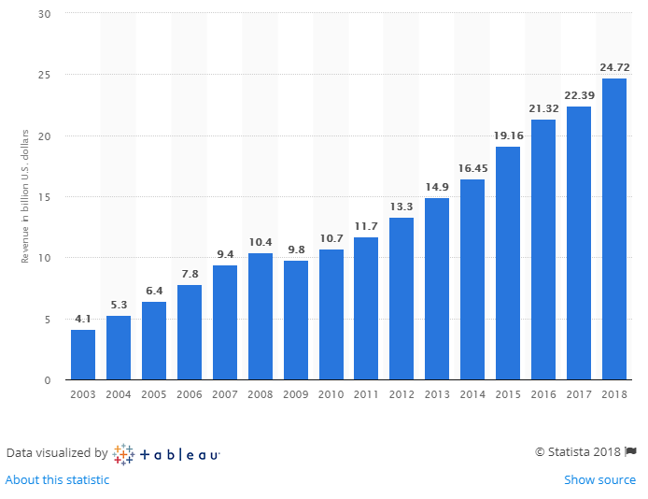
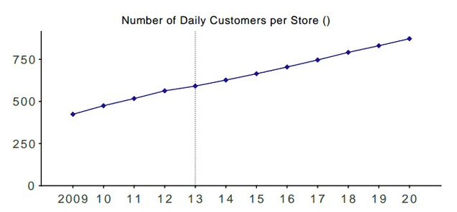
Business Requirements
Be able to serve 1K customers per day per store and 30K starbuck stores worldwide → That is 30M orders per day!
Be able to scale the platform to support 20% ~ 30% year-over-year growth of the number of orders.
(source: www.businessinsider.com)
(source: www.statistica.com)

Slide 3
System Requirements
Monthly Average Availability 99.99%
Be able to support rolling upgrades
Be able to scale out for the peek business hours
Be able to scale back at normal hours
Be able to analyze the customer traffics for the order conversion rate

Slide 4
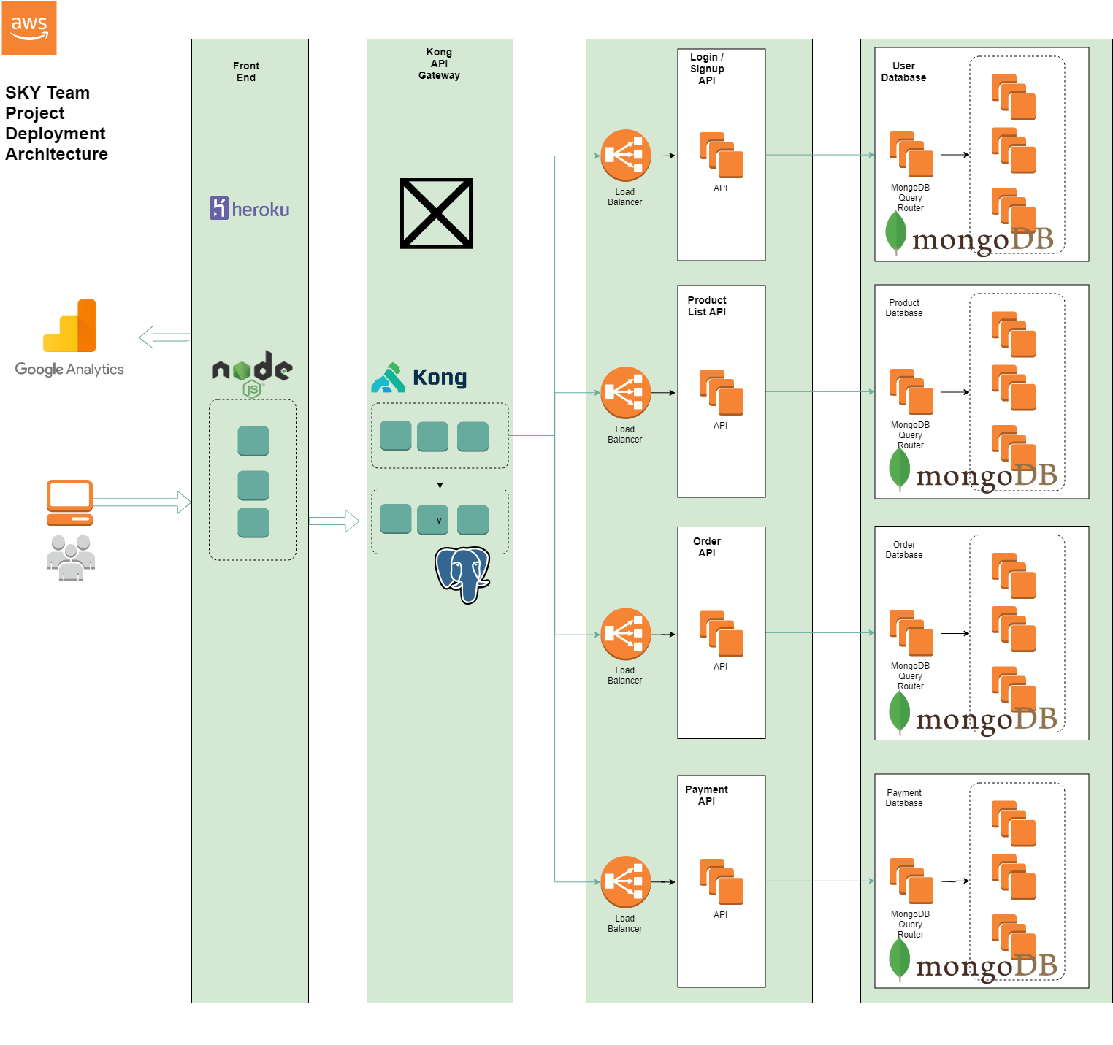
Architecture
Overview
Database layer - cluster and sharding
API layer - EC2 instances and load balancer
Kong API gateway - Kubernetes Services
Front End UI - Kubernetes Service
Front End UI - Heroku CI/CD pipeline
Google Analytics Tracking

Slide 5
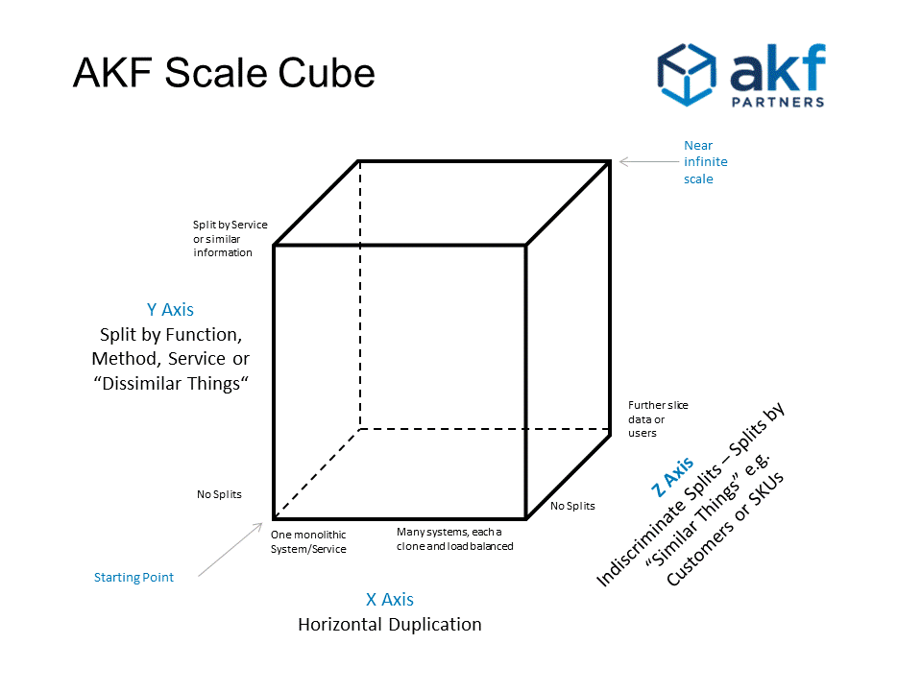
Scalability
Follows AKF model
X-axis: Replicate service for both frontend and backend
Y-axis: Split services into microservices
Login, Catalog, Order, Payment
Z-axis: Data sharding/Caching
Login, Catalog, Order, Payment

Slide 6
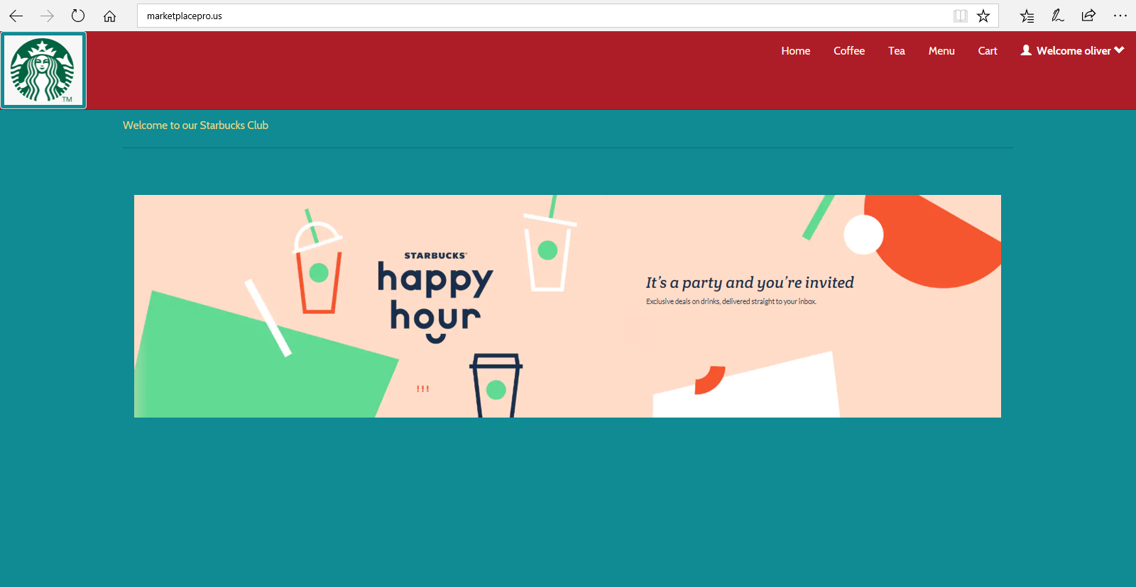
Live Demo

Slide 7
Frontend - Kubernetes Service
Implemented in Node.JS
First deployed to Heroku
https://sky-starbucks.herokuapp.com/
Single point of failure
Deployed as Kubernetes Services
Auto scaling, high availability
http://www.marketplacepro.us/

Slide 8
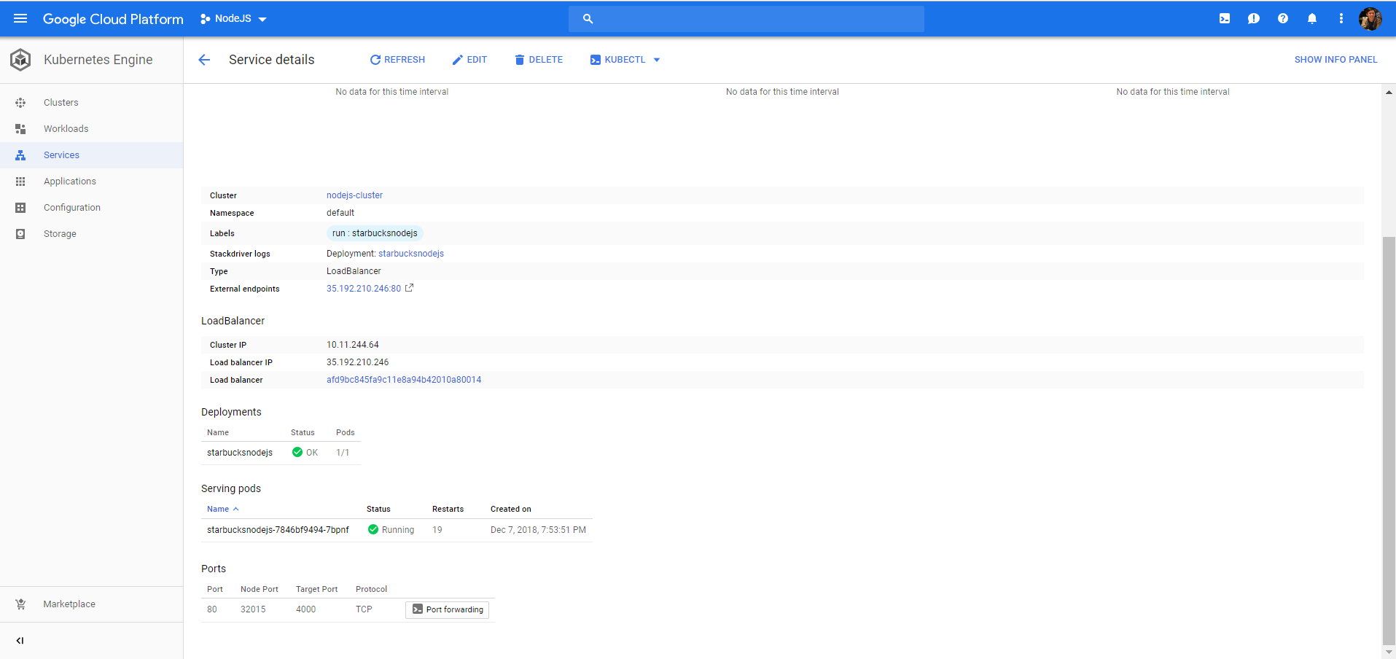

Slide 9
Kong Gateway - Kubernetes Service
Kong Deployed as a Kubernetes Service on Google Cloud Platform
Auto scaling, high availability
Kong using a Postgres database
Redirects based on URI
Cluster size: 3
Example:
http://www.marketplacepro.us/products/:id

Slide 10
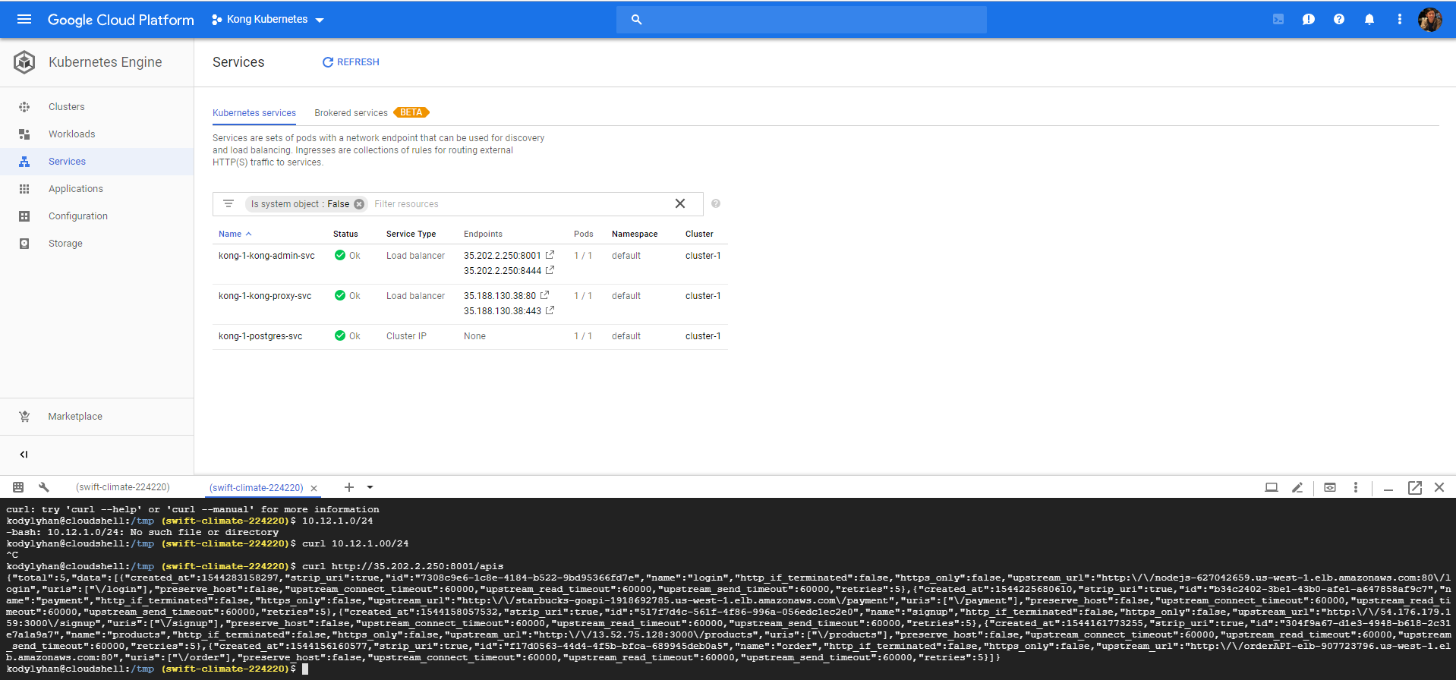

Slide 11
Microservices - Login
Sign Up API
POST "/signup"
Login API
POST "/login/"
Log Off API
GET "/off"
Data Sharding
Key: last name

Slide 12
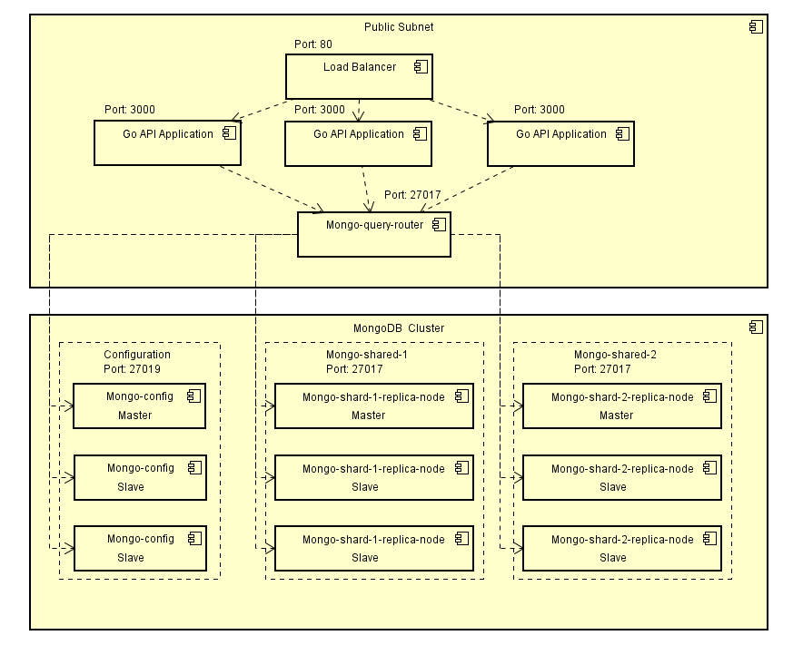
Microservices Login Architecture

Slide 13
Microservices - Products
GOAPI for Products:
GET /products -> get all the products
GET /products/:id -> get individual product
PUT /products/:id -> update product inventory

Slide 14
Microservices - Orders
Create Order API
POST "/user/{user_id}/order"
Complete Order API
POST "/user/{user_id}/order/{order_id}"
Get Order Status
GET "/user/{user_id}/order/{order_id}"
Get Orders History
Get "/user/{user_id}/orders"
Data Sharding
Key: order_id

Slide 15
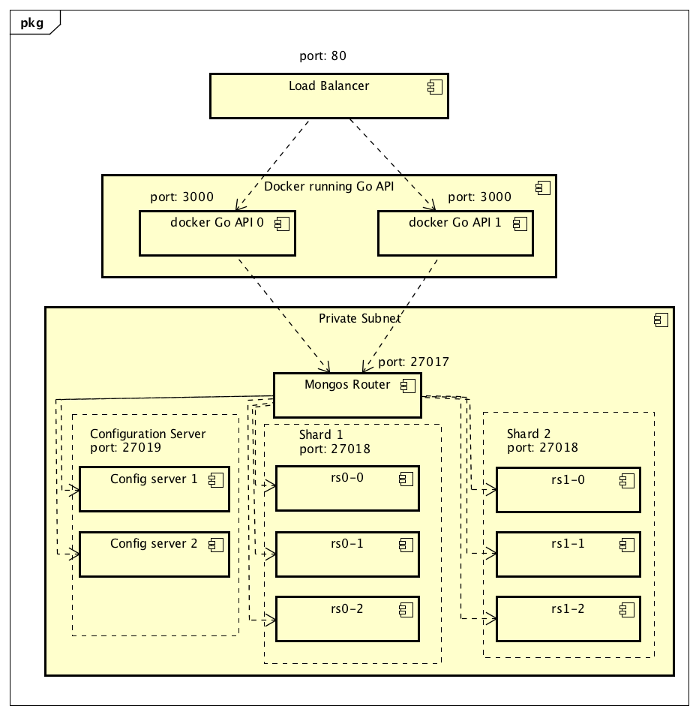
Microservices - Orders Architecture

Slide 16
Microservices - Payment
Create Payment Order API
POST "/payment/{orderid}"
Complete Payment API
POST "/payment/{userid}/{orderid}/{amt}"

Slide 17
Microservices - Payment

Slide 18
Future Improvement
Enable two Mongos Router to avoid single point of failure
Enable third party Login authentication (Facebook, Google)
Validate the payment information
Implement notification feature about order process
Have mobile app version
Make Kubernetes Frontend more stable

Slide 19
Thank you!

